Slide 1


EventFlow
EVENT MANAGEMENT SYSTEM
Milestone 2
Team 12
1.
Notes:
We are from Team 12 and this is 2nd milestone presentation of Event managemnet systm

Slide 2





EventFlow
Meet Our Team
Ravindu Abesinghe
Nilakshi Induwara
Nipuni Sathya
E/19/004
E/19/028
E/19/167
Shenal Mendis
Prageeth Dananjaya
E/19/240
E/19/431
Team 12
2.

Slide 3

The Problem
Event Organizer
No way to analyze, access and improve Events
Event Attendee
Quick access to event info and schedule is blocked behind apps
3.
Notes:
So the problem that we identified was when there are multiple evnets going on for event organizers there is no easy way to access and get information about these events. and for event attendee also has to be stuck between apps and usually no quick way.

Slide 4

Solution
A Human-less Event Attendance management system
4.

Slide 5

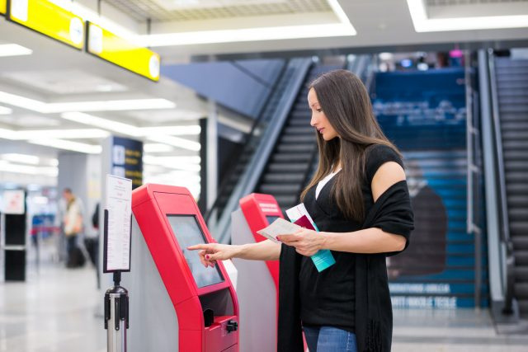
EventFlow
What our system does
Tracks and analyses attendees entering and leaving
Displays information on attendee’s event information through a hub
Team 12
5.
Notes:
So what our system mainly does is it tracks when atttende is entetring or leaving through event
and also atendee can see the information about events even before entering the event

Slide 6







EventFlow
Central Hub
System Design
Display Unit
Reader
The overview of the system
Team 12
6.
Notes:
So the system goes like this when a person comes or goes through the front door reader senese it and send that data to central hub . Also atendee can get all the information about ongoing and upcoming events by using his tag to display unit

Slide 7















EventFlow
Application Tier
Data Tier
ESP32
Long-range RFID reader
ESP32
Central hub
Short-range RFID reader
Dashboard
Display unit
High-level Architecture
Team 12
7.

Slide 8



EventFlow
Back-end
Front-end
Data Tier
S3
API gateway
S3
EC2
AWS lamda
Dynamodb
Logic
Security and Authentication
AWS cloudwatch
Cloud Architecture
Team 12
8.

Slide 9
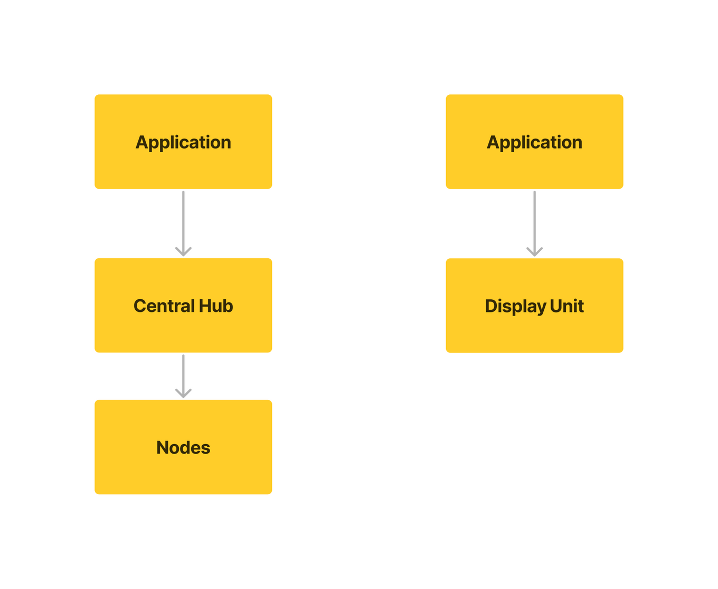
EventFlow
Data recieval
Database logic
Node control
Control Flow
Device Failure
Heighrachy of control through the complete system.
sending data
Team 12
10.

Slide 10
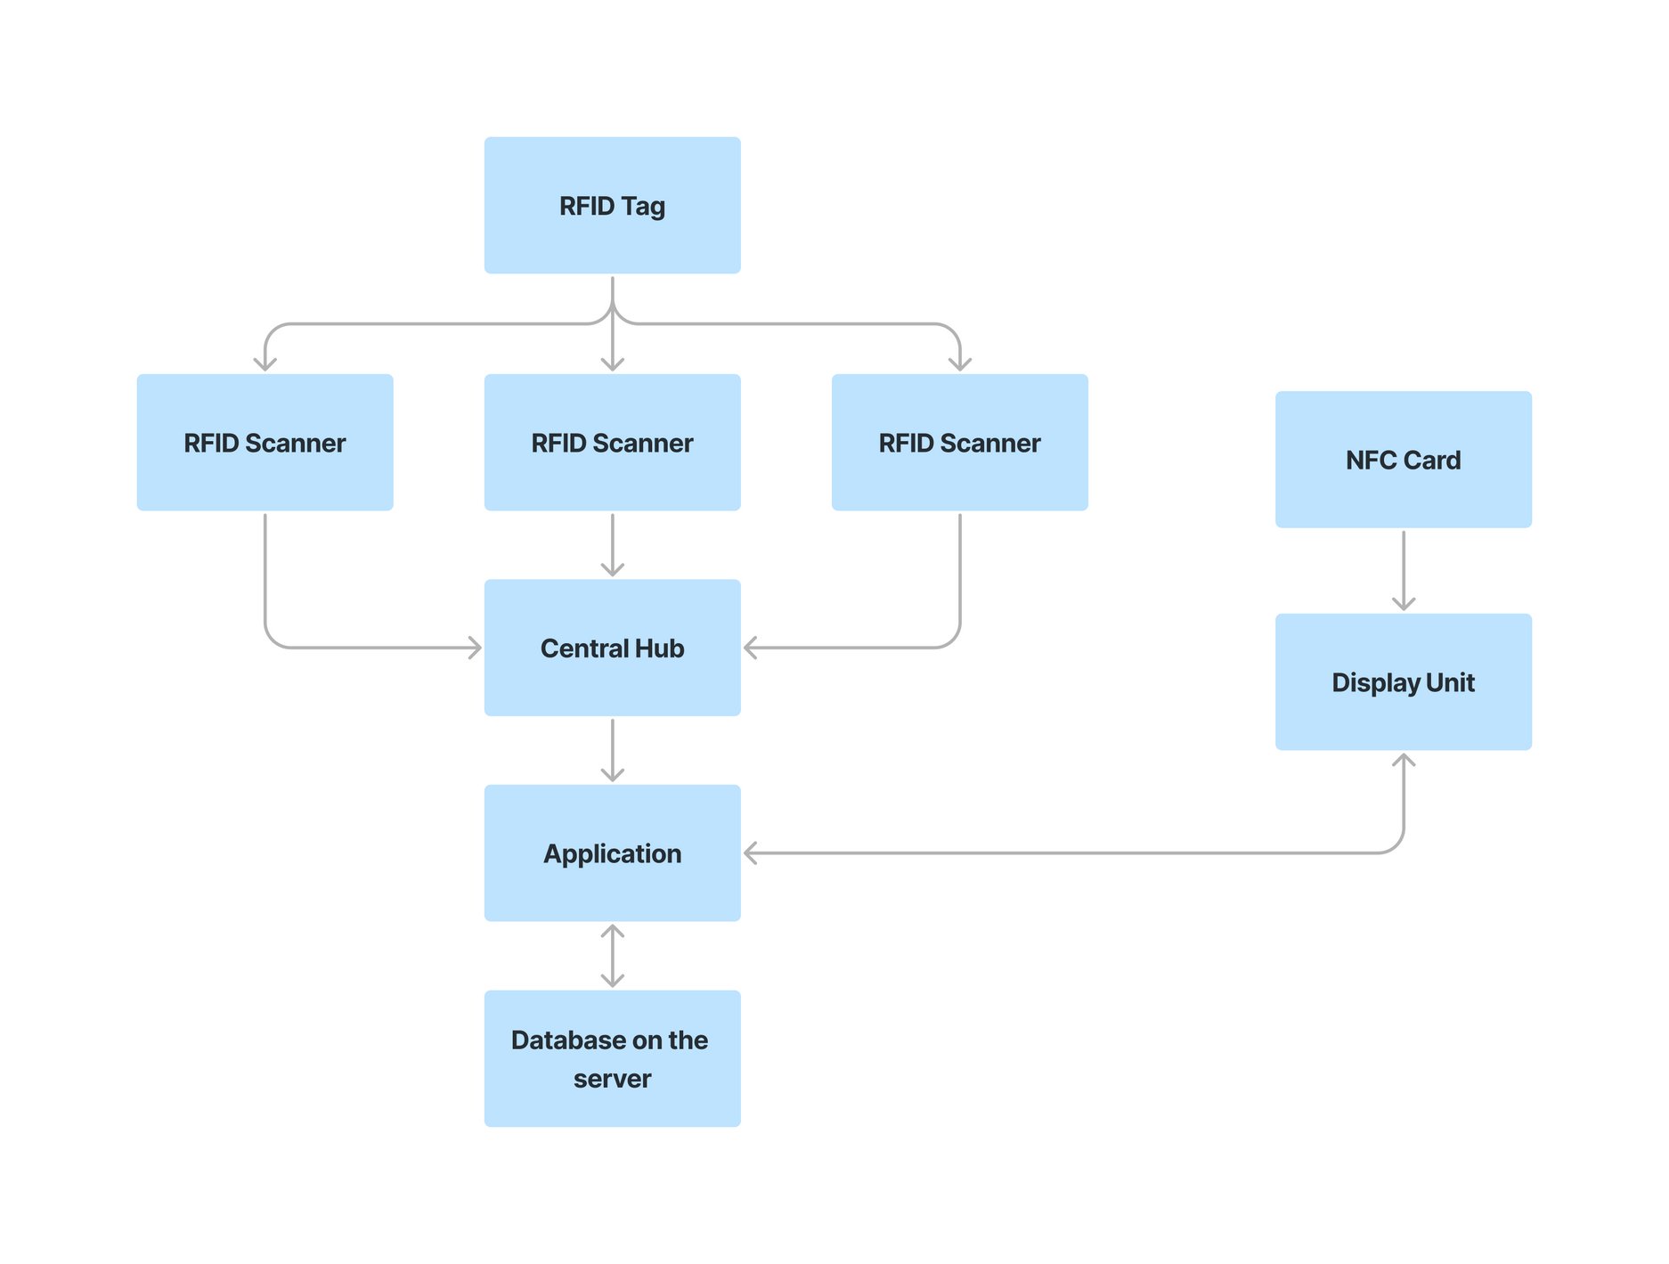

EventFlow
T
T
T
T
Data Flow
Data flow through the complete system.
T
Temperary data storage
P
P
Permenent data storage
Team 12
9.
10.

Slide 11

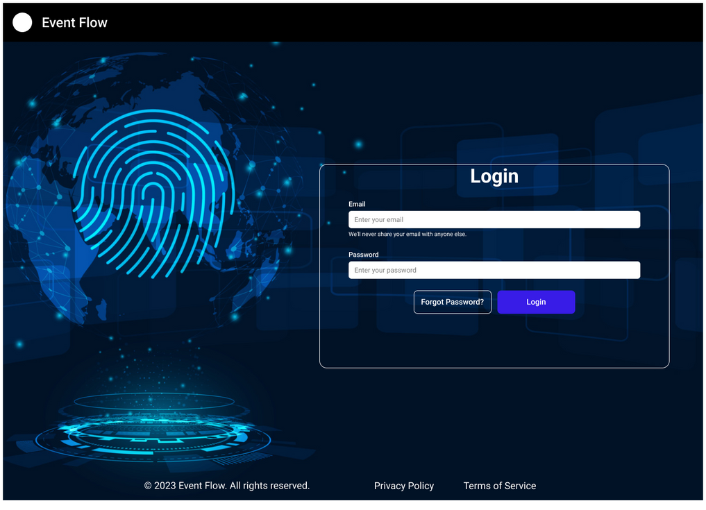
EventFlow
UX - User Interactions
Team 12
11.

Slide 12
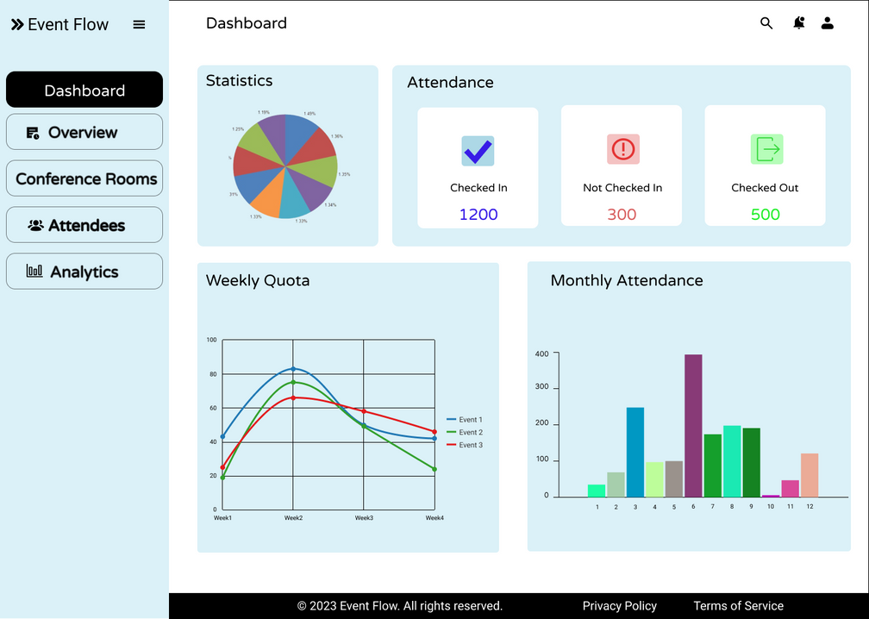
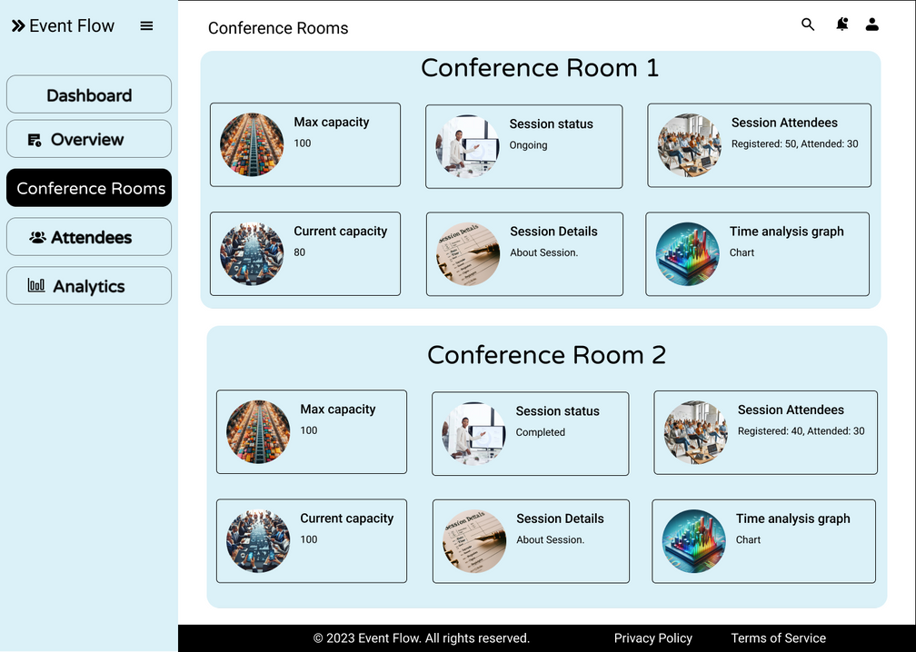
EventFlow
User Interface
Team 12
12.

Slide 13
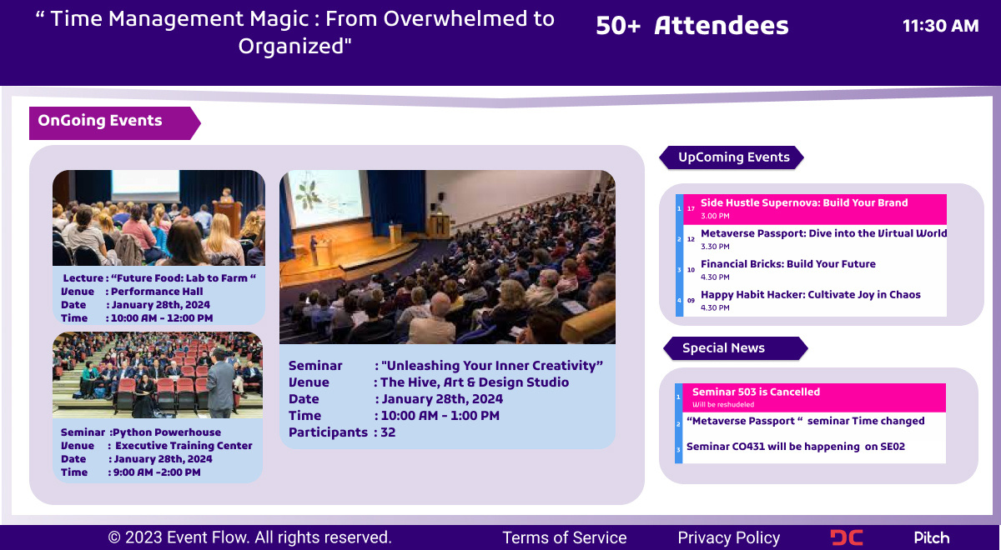
EventFlow
UI for Display Device
13.

Slide 14

EventFlow
Software Testing Plan
Unit Testing
Jest and React Testing Library
Integration Testing
Cypress and React Testing Library
End-to-End Testing
Cypress and Postman
Team 12
14

Slide 15
EventFlow
Software Testing Plan
Performance Testing
LoadRunner (Jmeter & K6)
Cross-Browser Testing
Team 12
15

Slide 16

EventFlow
Hardware Stack
Attendance Tracking Unit
Central Hub
Information Unit
Team 12
16.
Notes:
1
real-time Data transmission.
WebSocket minimizes latency by maintaining a persistent connection.
WebSocket has lower overhead compared to traditional HTTP.
2
HTTP/HTTPS is a widely adopted and standardized protocol,
HTTP is commonly used for building RESTful APIs,
HTTPS provides a layer of encryption,

Slide 17


EventFlow
Hardware Testing Plan
individual component testing
Functionality tests
Compatibility tests
Stress tests
Team 12
17

Slide 18

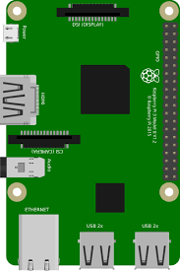



EventFlow
Hardware Testing Plan
ESP32 NODEMCU
Raspberry Pi 3
MFRC-522 RFID module
UHF RFID reader
flash Memory
Team 12
18

Slide 19

EventFlow
Failure Handling
Power Failure
-> Rechargeable LiPo batteries
Network Failure
-> Local Data Storage
-> Resend
Device Failure
-> Device Replacement
Team 12
19

Slide 20
EventFlow
Component | Qty. | Unit Price (LKR) | Cost (LKR)
UHF RFID Reader Module | 1 | 33328 | 33328
RFID tags(short range, Long range) | 10 | 100 | 1000
Flash Memory | 2 | 500 | 1000
Li-Po battery | 2 | 1980 | 3960
SPI SD Module | 2 | 150 | 300
Charging Module | 2 | 300 | 600
Boost Power Supply | 2 | 240 | 480
TOTAL 40668 LKR | TOTAL 40668 LKR | TOTAL 40668 LKR | TOTAL 40668 LKR
Tentative
Budget
Team 12
20.

Slide 21


EventFlow
THANK
YOU!
Team 12
21

Slide 22

EventFlow
Q and A
Team 12
22.

